Slide 1

DESIGN
‘PATTERN’
IN JAVA
[GoF Design Patterns]

Slide 2
[Creational Patterns]

Slide 3
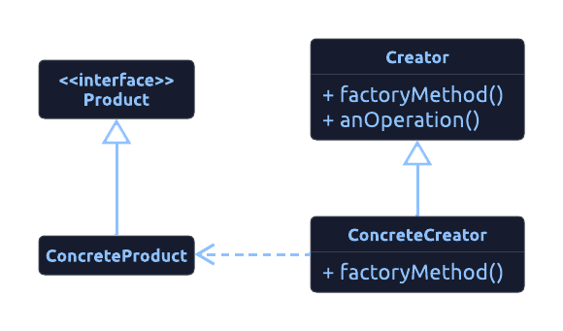
[ What is ‘Factory Method’? ]
[ Object Creational ]
Why?
<Exposes a method for creating objects, allowing subclasses to control the actual creation process./>
When?
<It used :
A class will not know what classes it will be required to create.
Subclasses may specify what objects should be created.
Parent classes wish to defer creation to their subclasses./>
Example
<For security, many application applications provides some sort of user & group control. When the application need to create a user, it delegates the process to various implementations. Most operations for each user will be handled by the parent user object, but the subclasses will specify the factory method that handles the distinctions in the creation of each type of user. Each of the AdminUser and StandardUser objects in a system extends the User object. The AdminUser object may do additional duties to assure access, whereas the StandardUser object may do the same to restrict access. />

Slide 4
‘Factory Method’
[Implementation & Testing]
<We are going to:
Create interface Polygon.
Create a concrete implementation of Triangle, Square, Pentagon for Polygon interface.
Implement class factory PolygonFactory that has a polygon factory getPolygone() which takes the number of sides as an argument & returns the appropriate implementation of this abstraction./>

Slide 5
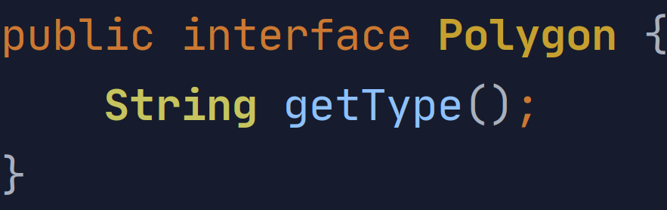
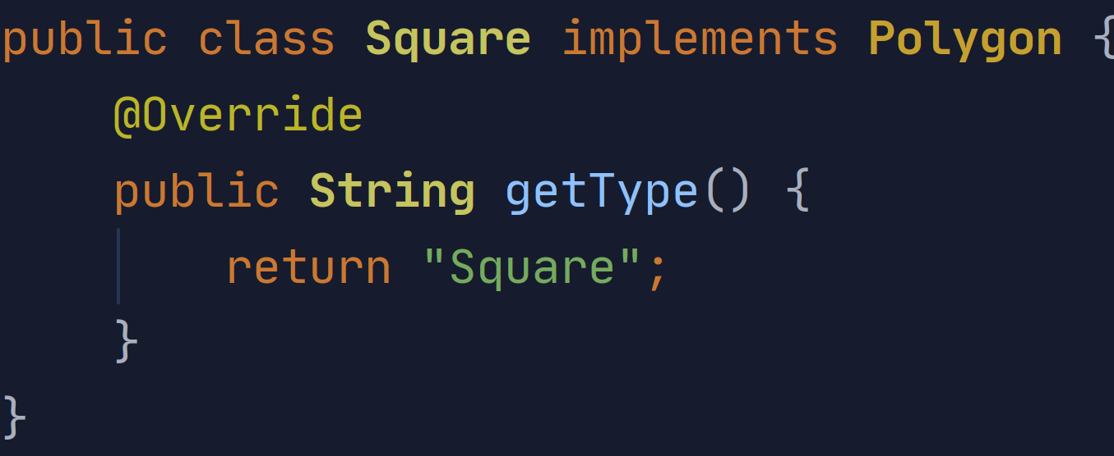
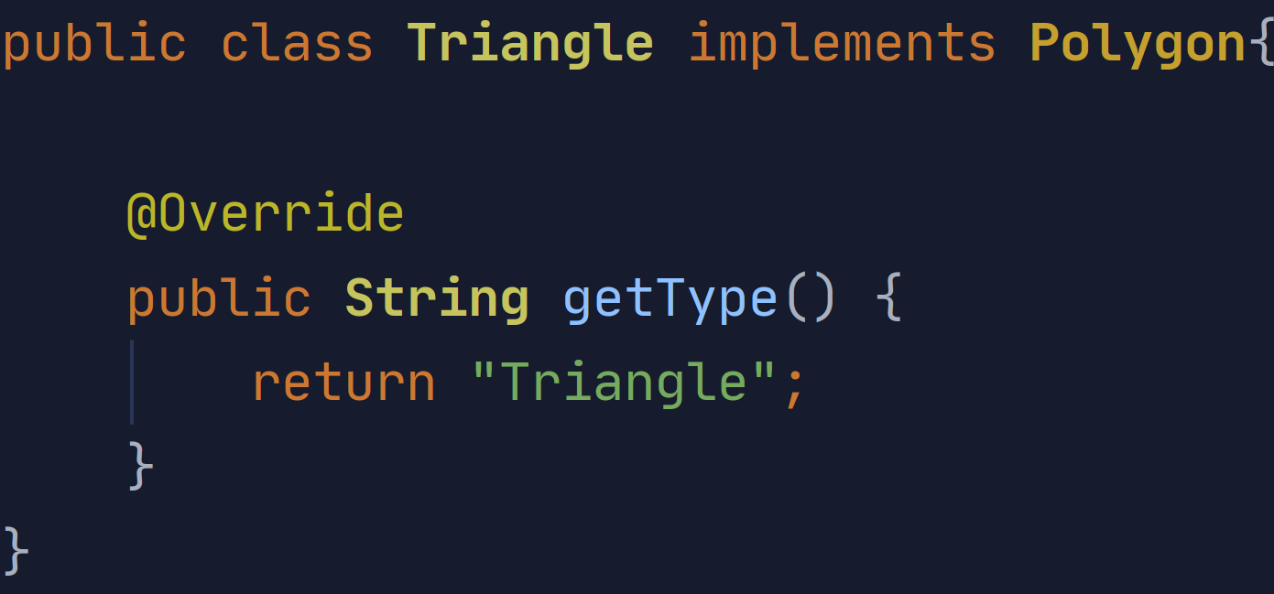
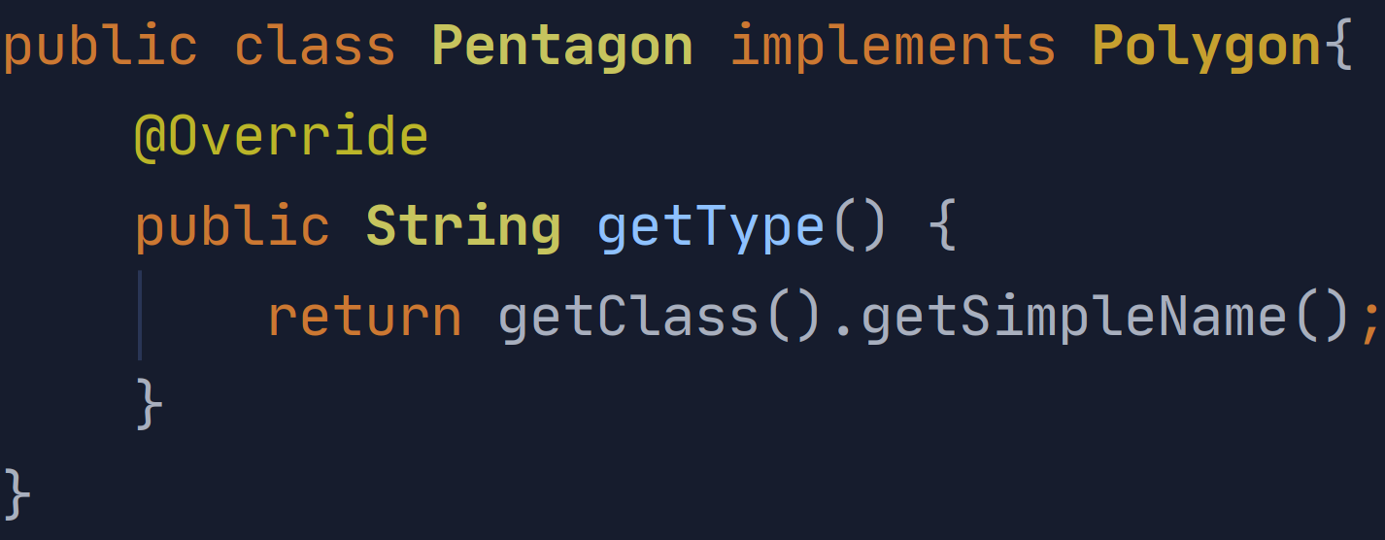
‘Factory Method’
[Implementation & Testing]

Slide 6
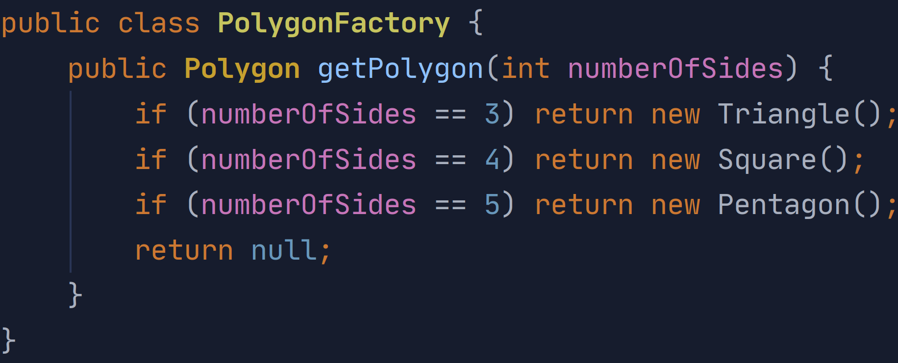
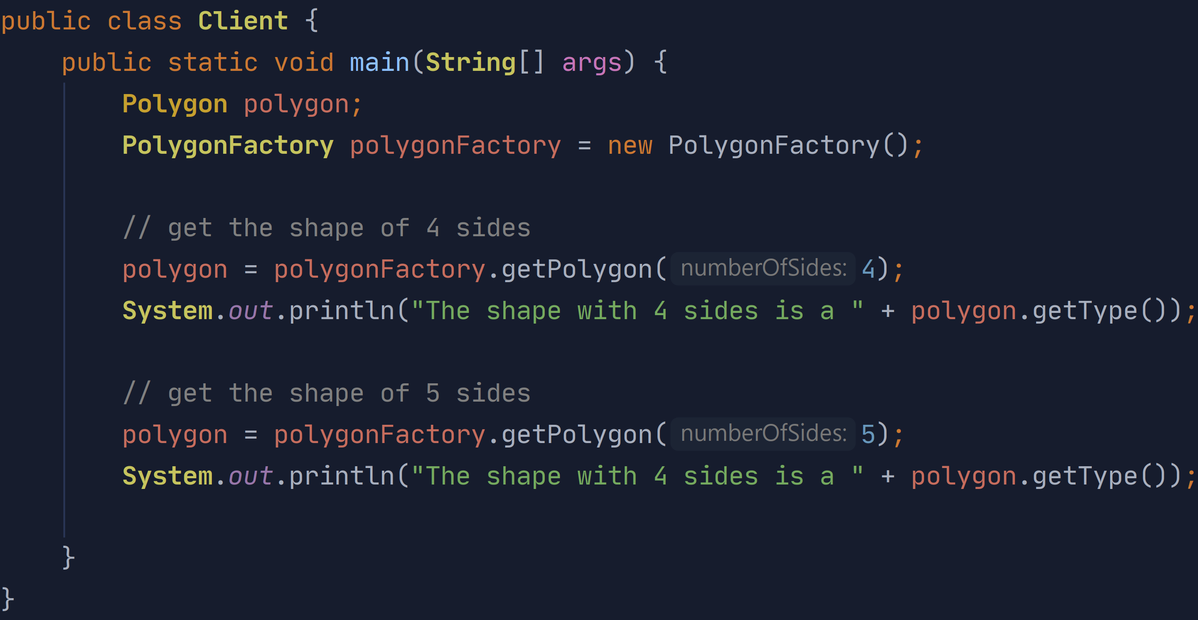
‘Factory Method’
[Implementation & Testing]

